Slide 1


FUNDAMENTAL OF EARTHQUAKE
Jeddah Yanti, S.Si., M.Sc.
Email : jeddahyanti93@g.ncu.edu.tw

Slide 2
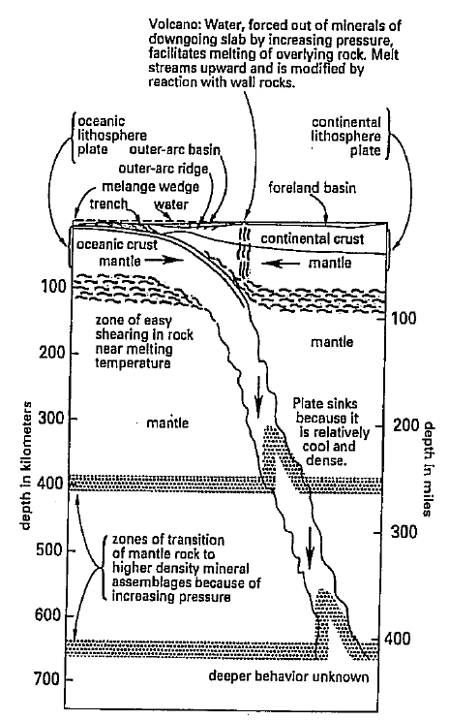
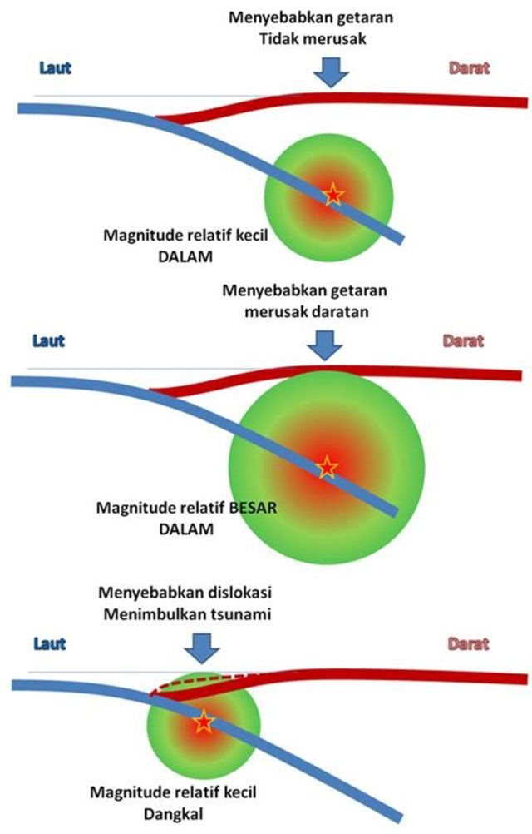
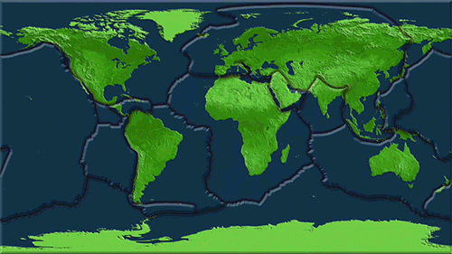
Causes of Earthquake
ENERGY

Slide 3
Worldwide Earthquakes 2000–2019
Magnitude | 2000 | 2001 | 2002 | 2003 | 2004 | 2005 | 2006 | 2007 | 2008 | 2009 | 2010 | 2011 | 2012 | 2013 | 2014 | 2015 | 2016 | 2017 | 2018 | 2019
8.0+ | 1 | 1 | 0 | 1 | 2 | 1 | 2 | 4 | 0 | 1 | 1 | 1 | 2 | 2 | 1 | 1 | 0 | 1 | 1 | 1
7–7.9 | 14 | 15 | 13 | 14 | 14 | 10 | 9 | 14 | 12 | 16 | 23 | 19 | 12 | 17 | 11 | 18 | 16 | 6 | 16 | 9
6–6.9 | 146 | 121 | 127 | 140 | 141 | 140 | 142 | 178 | 168 | 144 | 150 | 185 | 108 | 123 | 143 | 127 | 130 | 104 | 117 | 135
5–5.9 | 1344 | 1224 | 1201 | 1203 | 1515 | 1693 | 1712 | 2074 | 1768 | 1896 | 2209 | 2276 | 1401 | 1453 | 1574 | 1419 | 1550 | 1455 | 1674 | 1492
Estimated Deaths | 231 | 21357 | 1685 | 33819 | 298101 | 87992 | 6605 | 708 | 88708 | 1790 | 226050 | 21942 | 689 | 1572 | 756 | 9624

Slide 4
 | Mag | Location | Alternative Name | Date (UTC) | Time (UTC) | Latitude | Longitude | References
1. | 9.5 | Bio-Bio, Chile | Valdivia Earthquake | 1960-05-22 | 19:11 | 38.14°S | 73.41°W | Kanamori & Anderson, 1975
2. | 9.2 | Southern Alaska | 1964 Great Alaska Earthquake, Prince William Sound Earthquake, Good Friday Earthquake | 1964-03-28 | 03:36 | 60.91°N | 147.34°W | Kanamori & Anderson, 1975
3. | 9.1 | Off the West Coast of Northern Sumatra | Sumatra-Andaman Islands Earthquake, 2004 Sumatra Earthquake and Tsunami, Indian Ocean Earthquake | 2004-12-26 | 00:58 | 3.30°N | 95.98°E | Duputel et al., 2012
4. | 9.1 | Near the East Coast of Honshu, Japan | Tohoku Earthquake | 2011-03-11 | 05:46 | 38.30°N | 142.37°E | Duputel et al., 2012
5. | 9.0 | Off the East Coast of the Kamchatka Peninsula, Russia | Kamchatka, Russia | 1952-11-04 | 16:58 | 52.62°N | 159.78°E | Kanamori, 1976
6. | 8.8 | Offshore Bio-Bio, Chile | Maule Earthquake | 2010-02-27 | 06:34 | 36.12°S | 72.90°W | Duputel et al., 2012
7. | 8.8 | Near the Coast of Ecuador | 1906 Ecuador–Colombia Earthquake | 1906-01-31 | 15:36 | 0.96°N | 79.37°W | Kanamori, 1977
8. | 8.7 | Rat Islands, Aleutian Islands, Alaska | Rat Islands Earthquake | 1965-02-04 | 05:01 | 51.25°N | 178.72°E | Kanamori & Anderson, 1975
9. | 8.6 | Eastern Xizang-India border region | Assam, Tibet | 1950-08-15 | 14:09 | 28.36°N | 96.45°E | Kanamori, 1977
10. | 8.6 | Off the West Coast of Northern Sumatra |  | 2012-04-11 | 08:39 | 2.33°N | 93.06°E | Duputel et al., 2012
11. | 8.6 | Northern Sumatra, Indonesia | Nias Earthquake | 2005-03-28 | 16:10 | 2.09°N | 97.11°E | NEIC
12. | 8.6 | Andrean of Islands, Aleutian Islands, Alaska |  | 1957-03-09 | 14:23 | 51.50°N | 175.63°W | Johnson et al., 1994
13. | 8.6 | South of Alaska | Unimak Island Earthquake, Alaska | 1946-04-01 | 12:29 | 53.49°N | 162.83°W | Lopez & Okal, 2006
14. | 8.5 | Banda Sea |  | 1938-02-01 | 19:04 | 5.05°S | 131.61°E | Okal & Reymond, 2003
15. | 8.5 | Atacama, Chile | Chile-Argentina Border | 1922-11-11 | 04:33 | 28.29°S | 69.85°W | Kanamori, 1977
16. | 8.5 | Kuril Islands |  | 1963-10-13 | 05:18 | 44.87°N | 149.48°E | Kanamori & Anderson, 1975
17. | 8.4 | Near the East Coast of Kamchatka Peninsula, Russia | Kamchatka, Russia | 1923-02-03 | 16:02 | 54.49°N | 160.47°E | Okal, 1992
18. | 8.4 | Southern Sumatra, Indonesia |  | 2007-09-12 | 11:10 | 4.44°S | 101.37°E | NEIC
19. | 8.4 | Near the Coast of Southern Peru | Arequipa, Peru Earthquake | 2001-06-23 | 20:33 | 16.27°S | 73.64°W | Duputel et al., 2012
20. | 8.4 | Off the East Coast of Honshu, Japan | Sanriku, Japan | 1933-03-02 | 17:31 | 39.21°N | 144.59°E | Kanamori, 1971
BIG EARTHQUAKE

Slide 5
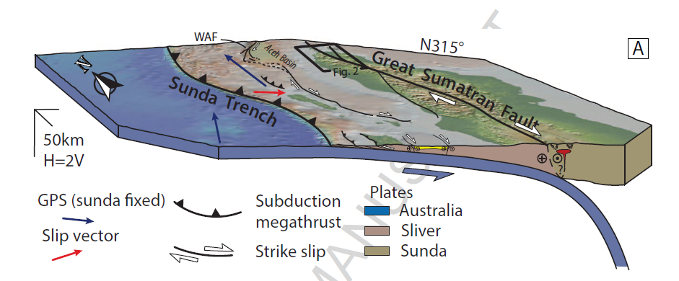
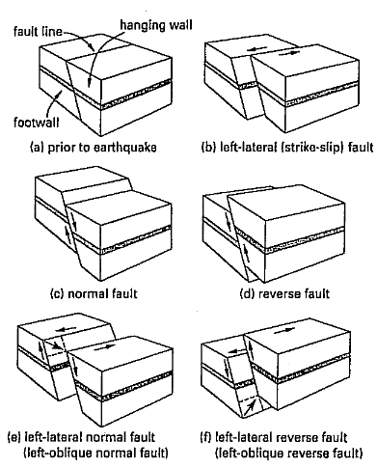
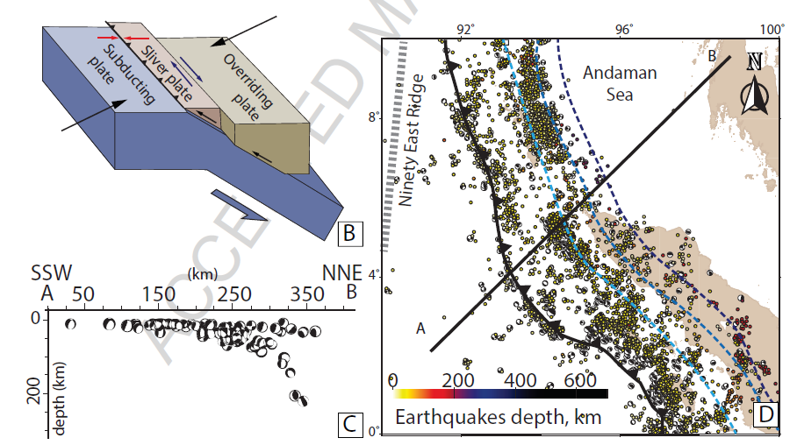
Active Faults as The Main Causes of Nias Earthquake
Faults Movements

Slide 6
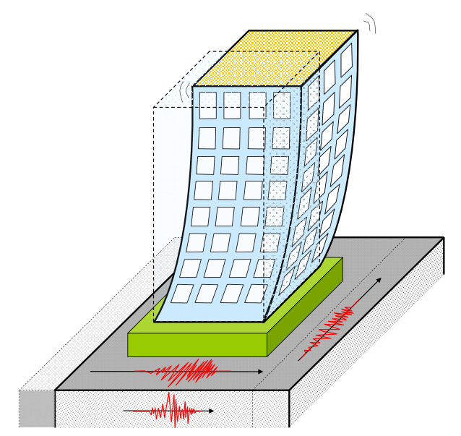
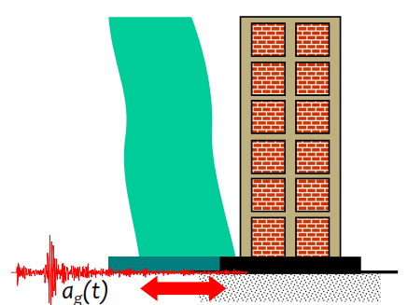
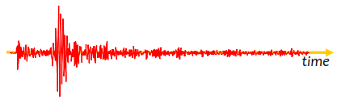
Seismic Design of Building Constructions

Slide 7
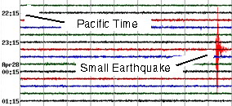
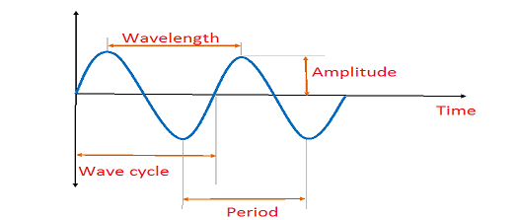
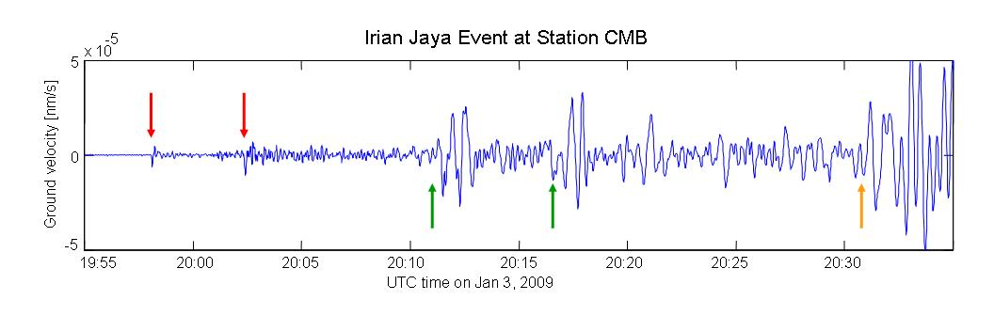
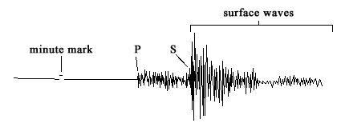
Types of waves on seismograph data
Example of seismograph data
Seismograph data is implementation of waves fungtion.
(λ)
(A)
(t)
(y)
(T)
Figure 1. Waves function
P
P
P waves are the fastest seismic waves, they will usually be the first ones that your seismograph records. The next set of seismic waves on your seismogram will be the S waves. S waves means the shape waves that shows big effect of earthquake hazard.
S
S
Figure 2. Types of waves on seismograph data

Slide 8
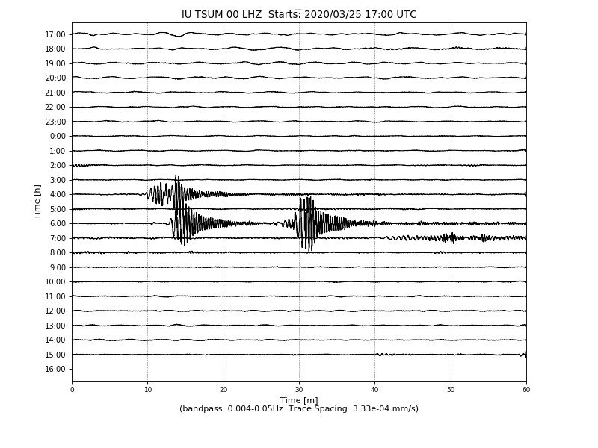
Task 2
1. Please draw how many P waves, S waves and Surface waves of your data.
2. Please count how many sequence of your seismograph data.
3. Please estimate the time of P waves, S waves and Surface waves of your data
Answer :
For example
1. In image
2. There are 3 P waves, 3 S waves, and 3 Surface waves.
3. a. 1st P waves = ± 06:12
1st S waves = ± 06:14
1st Surface waves = ± 06:14 – 06:25
b. 2nd P waves = ± 06:27
2nd S waves = ± 06:31
2nd Surface waves = ± 06:31 – 06:59
c. 3rd P waves = ± 04:xx
3rd S waves = ± 04:xx
3rd Surface waves = ± 04:xx – 04:xx
Your result can be .jpg, .doc, .pdf
Send to jeddah.yanti@staff.uma.ac.id
Filename
[Abcent no]_[Your name]_[Student ID]
Ex:
1_Lucinta gue kagak_14045
One sequence of Earthquake
One sequence of Earthquake
S
P
S
P
P
Surface waves
S
One sequence of Earthquake

