Slide 1


FUNDAMENTAL OF EARTHQUAKE
Jeddah Yanti, S.Si., M.Sc.
Email : Jeddah.yanti@staff.uma.ac.id

Slide 2
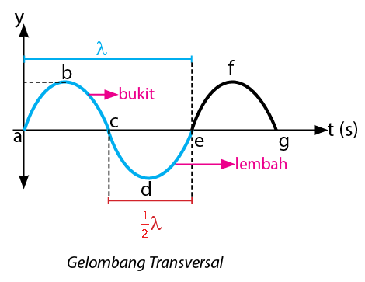
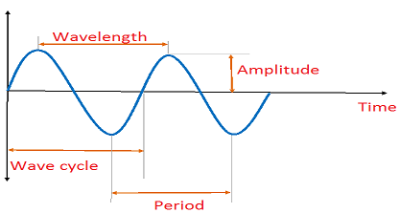
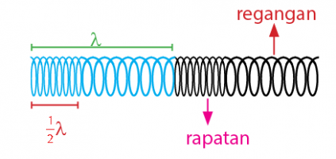
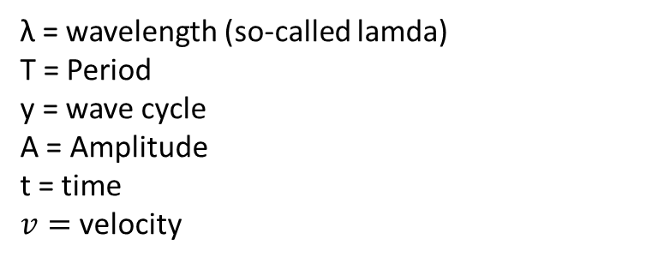
THE FUNDAMENTAL OF WAVES
TYPES OF WAVES
(λ)
(A)
(t)
(y)
(T)
Gelombang adalah energi getar yang merambat
Gelombang transversal adalah gelombang yang arah getarnya tegak lurus dengan arah rambat gelombang. Pada gempa disebut juga s waves.
Shock waves or shear waves – denoted s waves
Gelombang longitudinal adalah gelombang yang arah getarnya berimpit/sejajar dengan arah rambat gelombang. Pada gempa disebut juga p waves.
Push waves—denoted p waves
WAVE COMPONENTS
λ = wavelength (so-called lamda)
T = Period
y = wave cycle
A = Amplitude
t = time
$v=$ velocity

Slide 3
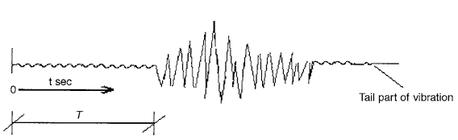
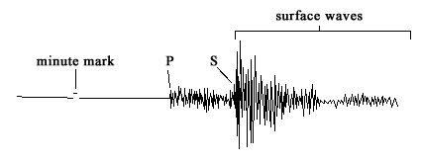
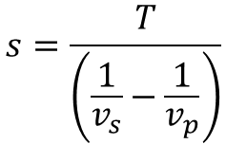
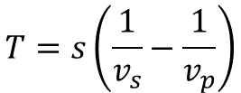

s is the distance from a given observation point to the hypocenter (km or miles)
v_{s} is the propagation velocity of the transverse waves (m/s, nm/s, μm/s)
v_{p} is The propagation velocity of the longitudinal (push waves) (m/s, nm/s, μm/s)
T is the time difference between the arrival of p and s waves (s)
$$T= \frac{s}{v_{s}}−\frac{s}{v_{p}}$$
$$s=\frac{T}{\left(\frac{1}{v_{s}}−\frac{1}{v_{p}}\right)}$$
$$T=s\left(\frac{1}{v_{s}}−\frac{1}{v_{p}}\right)$$
Period eq
Distance eq
Notes:
Jarak antara titik observasi ke sumber gempa = s (satuan km or miles)
kecepatan rambat gelombang transversal adalah v_{s}
kecepatan rambat longitudinal adalah v_{p}

Slide 4
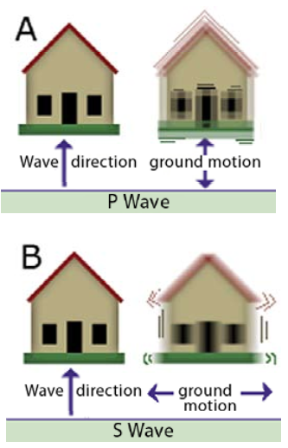
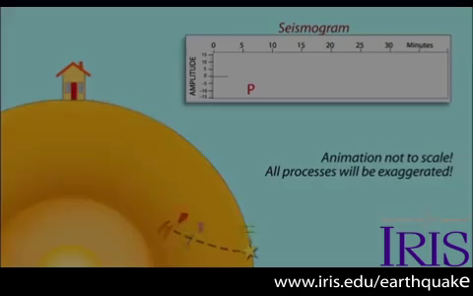
Timing of the seismic waves (P fastest)
The time (x-axis on the seismogram) it takes for the seismic waves to travel from an earthquake)
Different ways the seismic waves strike a building (P = bump; S = shear; surface = rolling wobble).

Slide 5
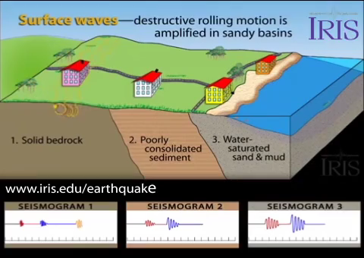
Seismic waves travel through different materials at different speeds
Seismic waves travel through different materials with different amplitudes
Bedrock has high-frequency low-amplitude waves (less destructive)
Sediment has low-frequency high amplitude waves (more destructive)

Slide 6
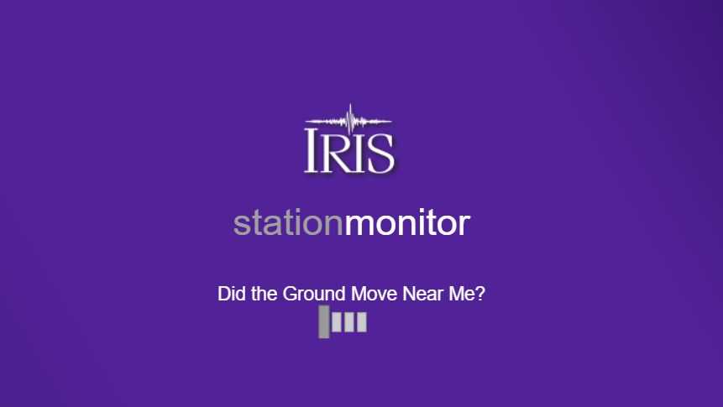
ONE OF APPLICATION FOR EARTHQUAKE OBERVATION

Slide 7
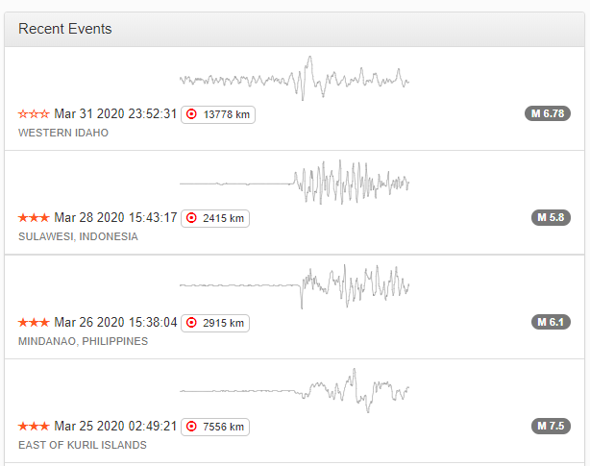
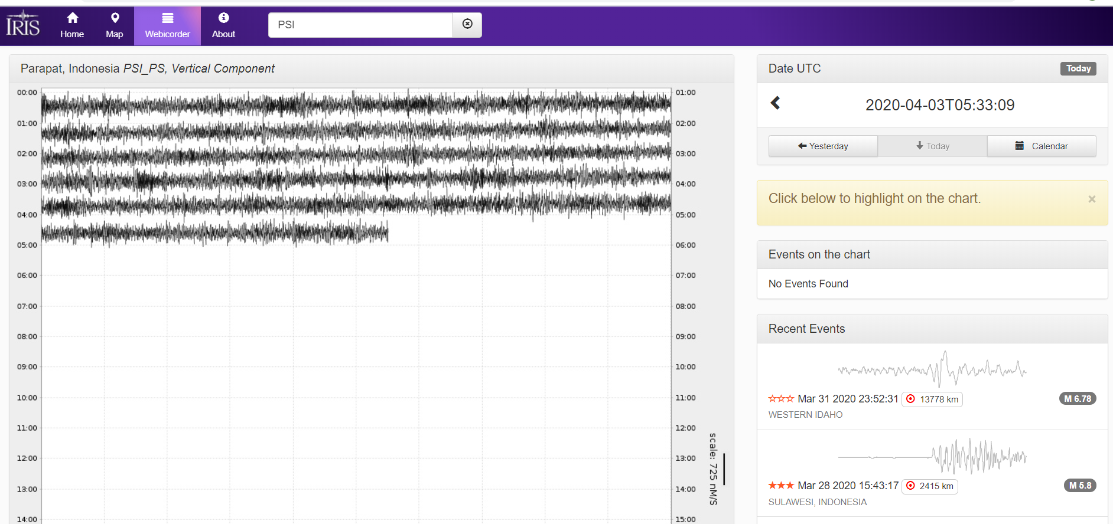
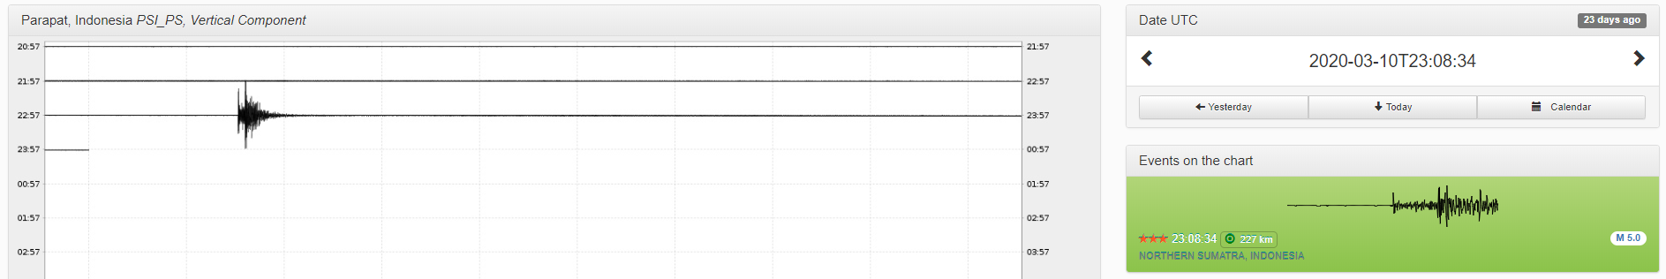
Langkah-langkah menggunakan station monitor apps atau website station monitor
1. Buka apps station monitor atau website dibawah ini
2. Perhatikan coloum bar recent events, klik salah satu case gempa yang tampil pada recent events
https://www.iris.edu/app/station_monitor/#Today/PS-PSI/webicorder/PS-PSI|11195893
3. Sehingga akan tampil data seismograph seperti dibawah, tentukan p wave, s wave and surface wave

Slide 8
TASK 3
Collect recent event of earthquake that consists of
Earthquake Location
Time of the Event UTC
Station - Event Distance
Depth
Magnitude
Determine
p waves and time arrival
s waves and time arrival
surface waves and time arrival

Slide 9
HOW TO COLLECT TASK 3
Date : Friday, April 4th 2020
Time : Start from 13.50 to 15.30 WIB
Lecturer : Jeddah Yanti, S.Si., M.Sc.
Course : Matrix and Vector
Types : Task 3
Time : PESP 17, Start from 10.00 to 11.40 WIB
Information :
You need to send file in word file or pdf file.
If your file in photos, please copy those photos and paste to word file.
Your file need to follow this format filename: STUDENT ID_NAME_TASK 3 Ex: 17xxxxxxx_Bunga_TASK 3
You need to send file by your account in elearning UMA or to my e-mail jeddah.yanti@staff.uma.ac.id with subject STUDENT ID_NAME_TASK 3
Ex: 17xxxxxxx_Bunga_TASK 3
*note : Subject and filename that does not follow the format above are considered to be ineligible

